Slide 1
Beacon App
Anthony Frazier and Marcos Moraes
University of South Carolina CSCE590 Spring 2017

Slide 2





Mobile App Development

Slide 3
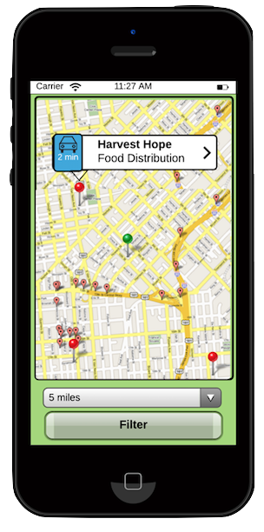
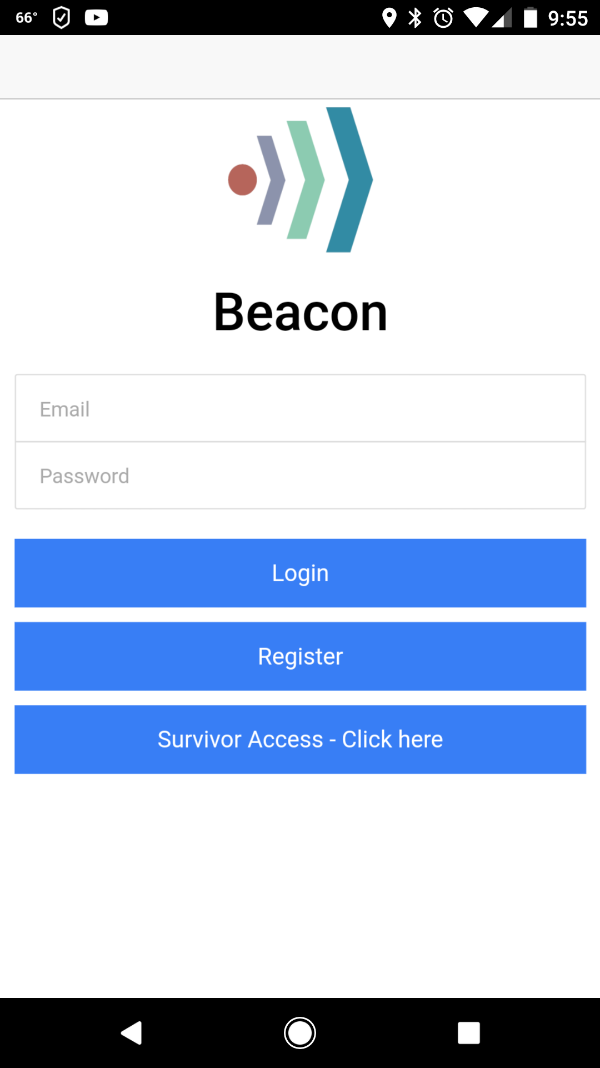
Login Screen
Login
Register
Survivor Access
Bypass function
Future functionality

Slide 4
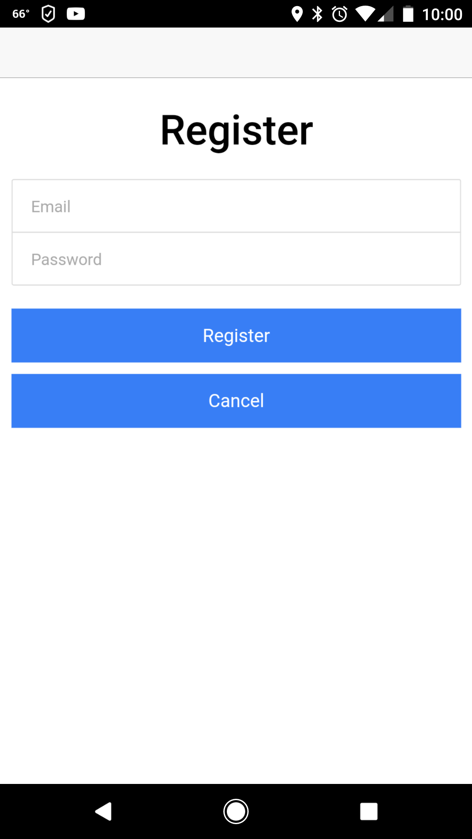
Registration
Registers all data in a Parse Database

Slide 5
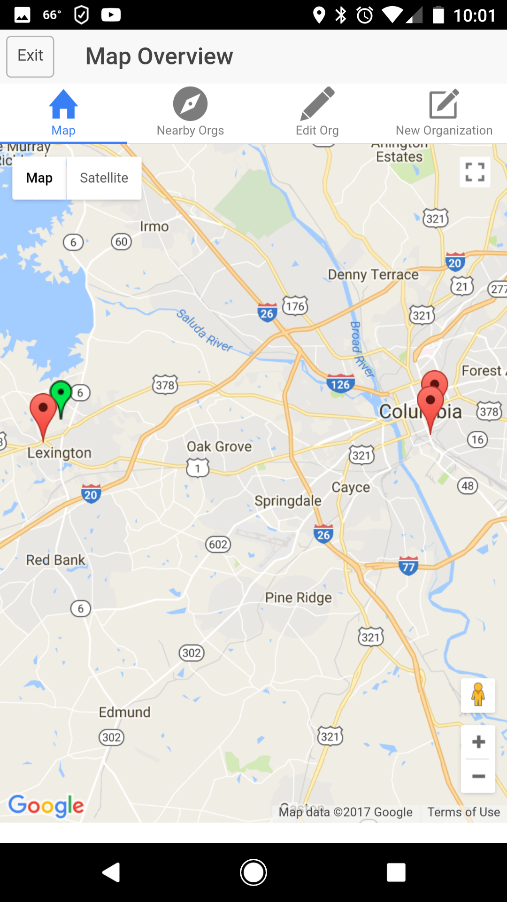
Map View
Green “You Are Here” marker dynamically based on current location
Map centers based on current location
Red organization markers based on their address

Slide 6
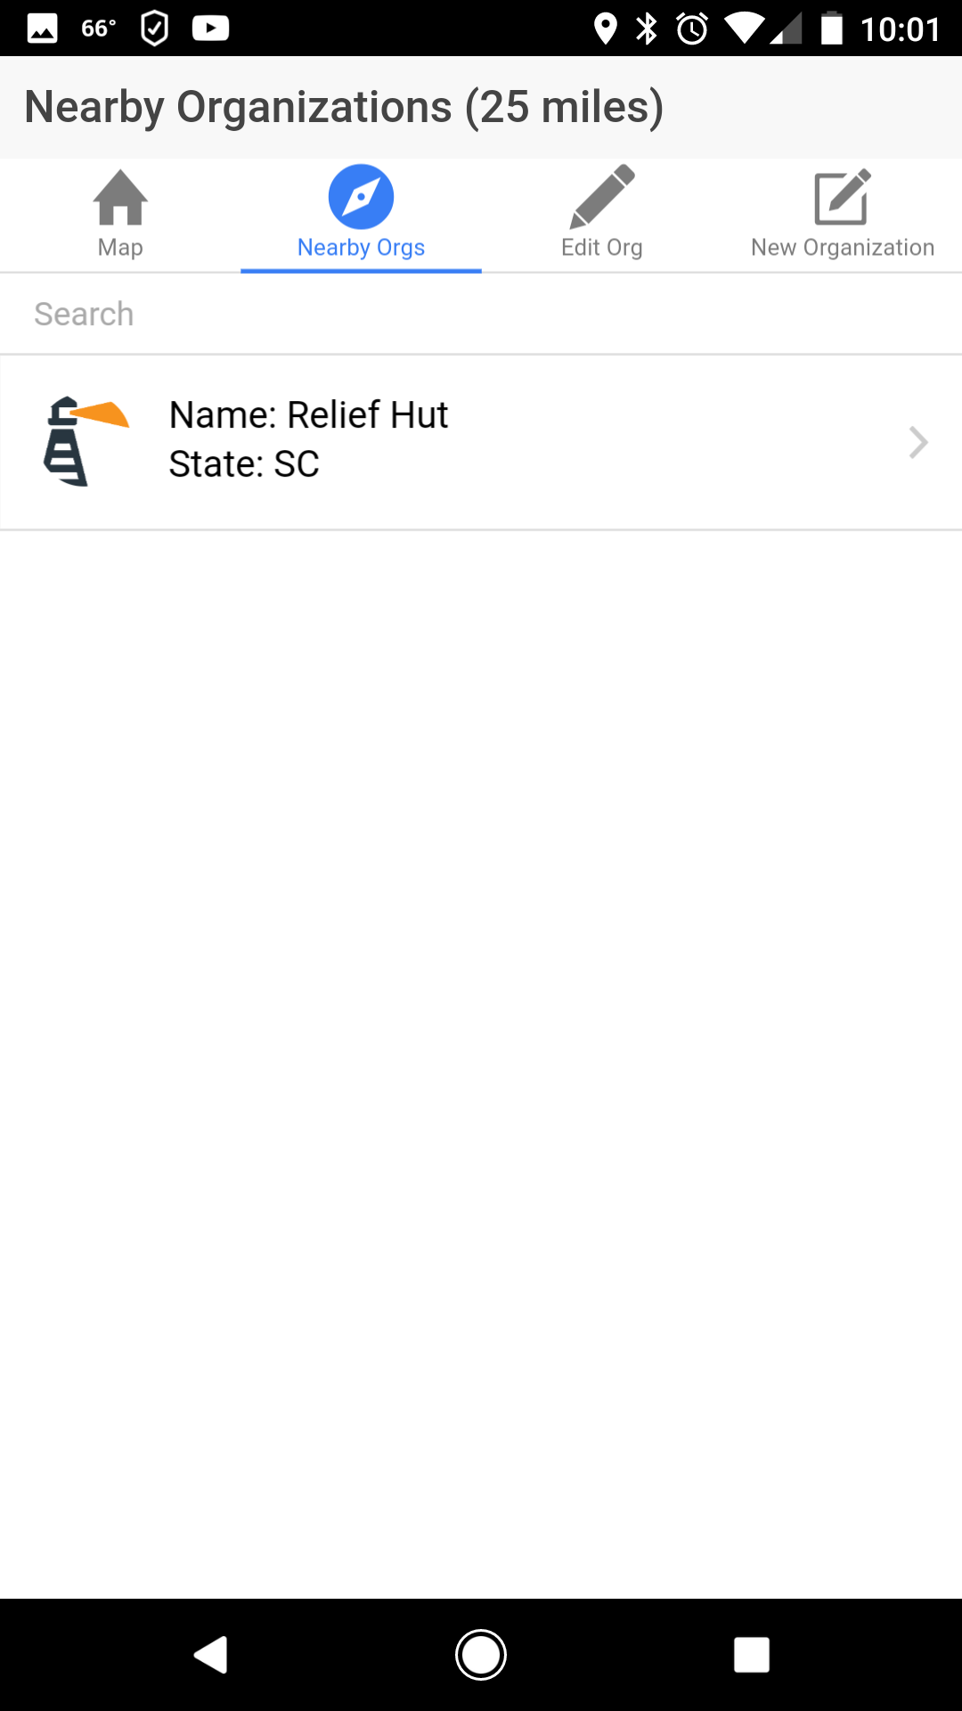
Nearby Organizations
Filters within a radius of 25 miles
Tap on organization for more detailed view

Slide 7
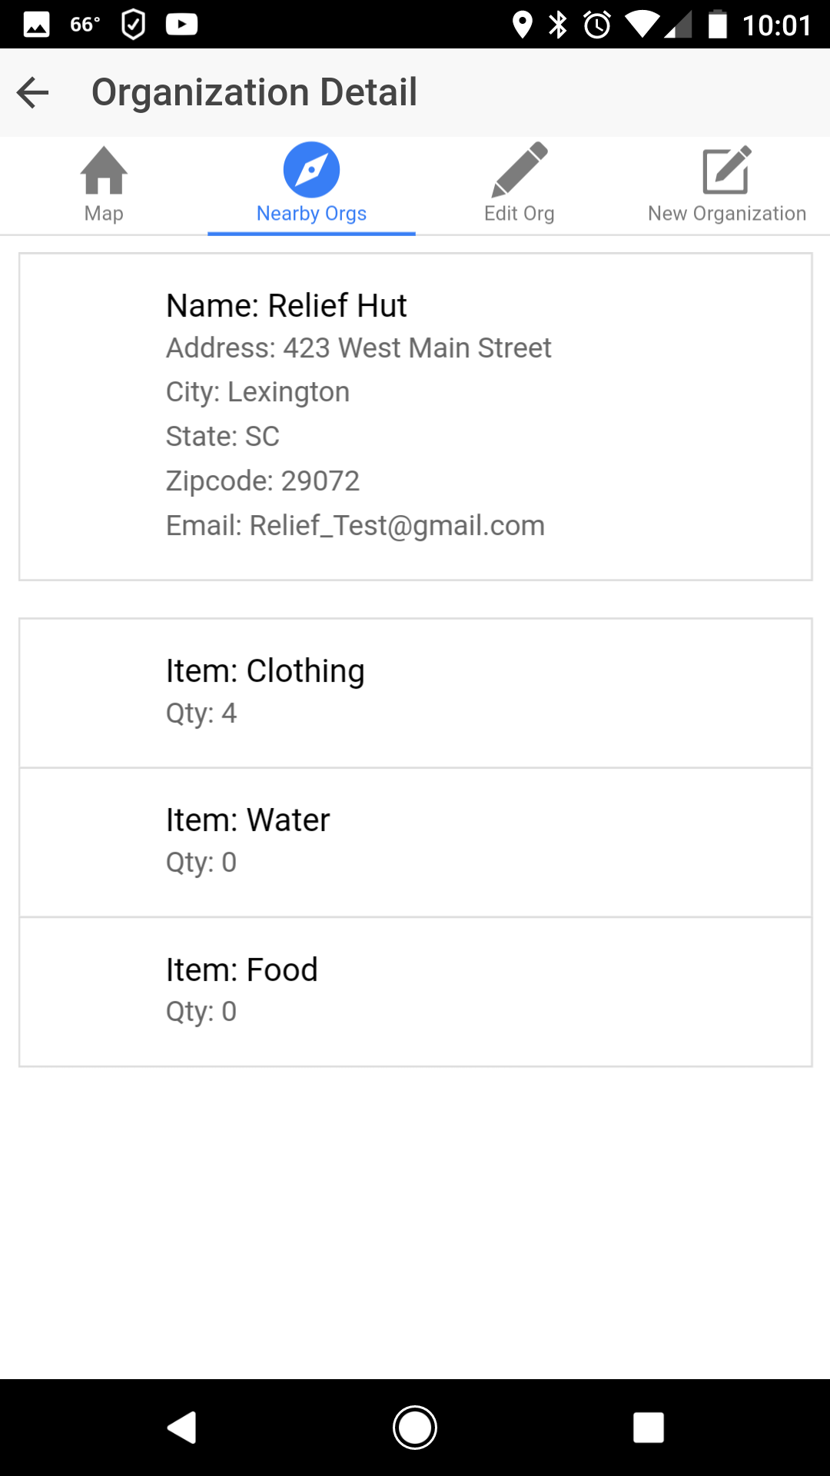
Organization Detail
Provides a more in-depth view of the organization:
Address
Email
Needs

Slide 8
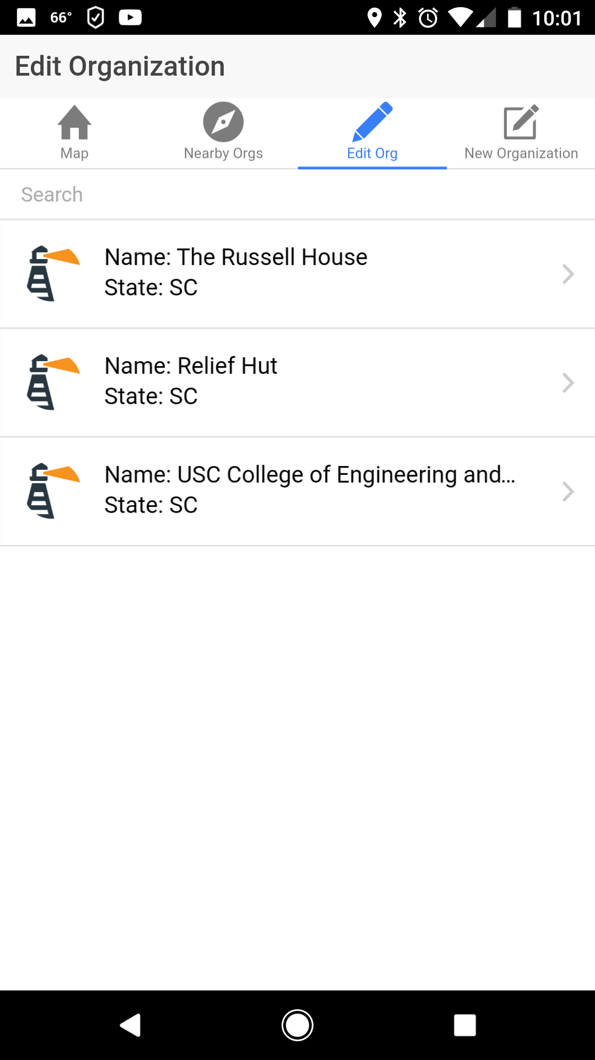
Edit Organization
Used to maintain inventory of organizations

Slide 9
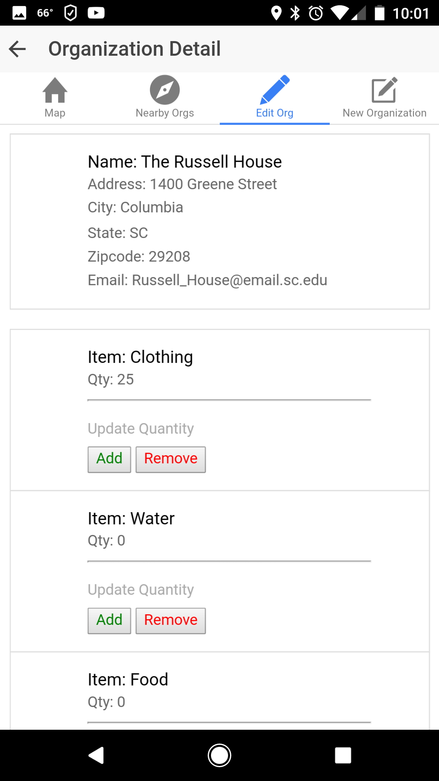
Organization Detail
Used to update quantities of supply demand

Slide 10
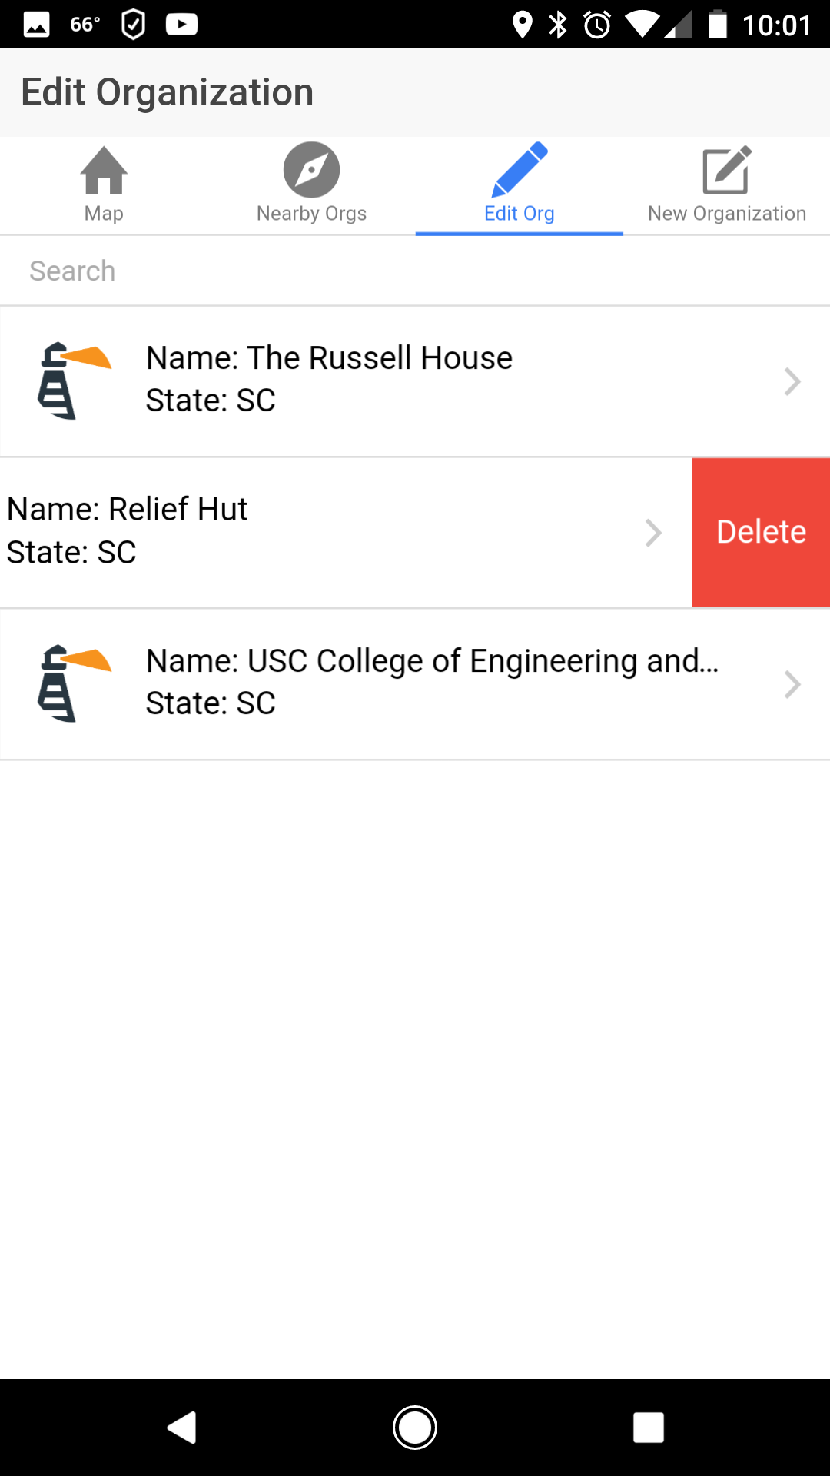
Edit Organization
Slide to delete organizations

Slide 11
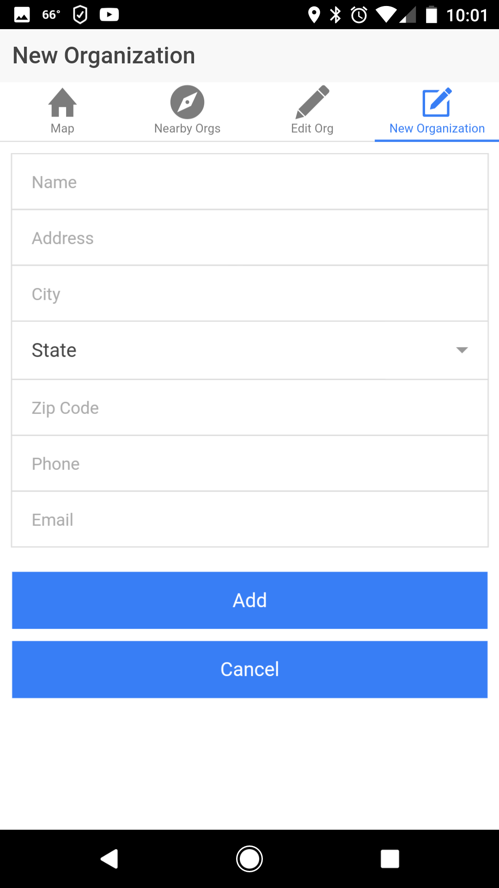
New Organization
Creates a new organization in database
Creates map entry based on latitude and longitude

Slide 12
Questions?

Slide 13
Beacon App
By Anthony Frazier and Marcos Moraes
University of South Carolina CSCE590 Spring 2017

